Slide 1
TCS-503: Design and Analysis of Algorithms
Learn DAA : From B K Sharma
Unit II
Advanced Data Structures:
Augmenting Data structures

Slide 2
Unit II
Learn DAA : From B K Sharma
Advanced Data Structures:
Red-Black Trees
Augmenting Data Structure
B-Trees
Binomial Heaps
Fibonacci Heaps
Data Structure for Disjoint Sets

Slide 3
Learn DAA : From B K Sharma
What is Augmentation?
Augmentation is a process of
extending a data structure
in order to support
additional fields / capability / functionality.

Slide 4
Learn DAA : From B K Sharma
Why do Augment a data structure?
Data structures
are used in many applications.
In most cases
a standard data structure
is sufficient
(possibly provided by a software library).

Slide 5
Learn DAA : From B K Sharma
Why do Augment a data structure?
Sometimes one needs
additional operations
that aren’t supported by
any standard data structure.
need to design new data structure?
Not always:
often augmenting an existing structure
is sufficient.

Slide 6
Learn DAA : From B K Sharma
Why do Augment a data structure?
New algorithms
using the new fields
will have to be implemented.
The original capabilities
usually must be maintained
and
will have to work
with the new fields.

Slide 7
Learn DAA : From B K Sharma
What are the steps of Augmentation Process?
Augmentation Process consists of four steps:-
1. Choose an underlying data structure:
Red-black trees
2. Determine additional information to maintain
size[x]
3. Verify that we can maintain additional information for existing data structure operations.
Show how to maintain size during modifying operations
4. Develop new operations
Developed OS-SELECT() & OS-RANK()

Slide 8
Learn DAA : From B K Sharma
What are the steps of Augmentation Process?
We don’t need to do these steps in strict order!
Red-black trees are very well suited to augmentation …

Slide 9
Learn DAA : From B K Sharma
How to find size[x]?
size[x] :
the number of (internal) nodes in the sub-tree rooted at x (including x itself)
size[x]
=
size[left[x]]
+
size[right[x]] + 1
26
3
17
1
41
1

Slide 10
Learn DAA : From B K Sharma
Example:
26
20
size[x] =
size[left[x]] + size[right[x]] + 1
17
12
41
7
14
7
21
4
47
1
30
5
10
4
16
2
21
1
19
2
28
1
38
3
7
2
12
1
14
1
20
1
35
1
3
1
39
1

Slide 11
Learn DAA : From B K Sharma
Examples for Augmenting DS
Order Statistics Tree
And
Interval trees

Slide 12
Learn DAA : From B K Sharma
Order Statistics Tree
Definition:
A red-black tree
with additional information size[x]
stored in each node.

Slide 13
Learn DAA : From B K Sharma
Order Statistics Tree
Step 3:
Verify that we can maintain additional information for existing data structure operations.
Show how to maintain size[x] during modifying operations such as INSERTION AND DELETION.

Slide 14
Learn DAA : From B K Sharma
Order Statistics Tree
INSERTION OPERATION
Do a regular binary search tree insertion
Fix the red-black properties
15
The new node gets a size of 1.
10
+1
Increment size[x] for each node x on the traversed path from the root to the leaves.
2
23
+1
12
+1
50
17
+1
15
size[x] = 1

Slide 15
Learn DAA : From B K Sharma
Order Statistics Tree
Step 4:
Develop new operations
Developed OS-SELECT() & OS-RANK()
OS-SELECT(x, i):
returns pointer to the key with rank i rooted at x.
OS-RANK(T, x):
returns rank of node with key x.

Slide 16
Learn DAA : From B K Sharma
Order Statistics Tree
OS-SELECT( x , i )
OS-SELECT( x , i)
1.
r ← size[left[x]] + 1
2.
if i=r then
3.
return x
4.
else if i < r then
5.
return OS-SELECT( left[x], i )
6.
else
7.
return OS-SELECT( right[r], i-r)

Slide 17
Learn DAA : From B K Sharma
Order Statistics Tree
OS-SELECT( x , i )
OS-SELECT(root[T},17)
Call OS-SELECT(root[T],17), i.e. we want to find the node whose rank is 17.

Slide 18
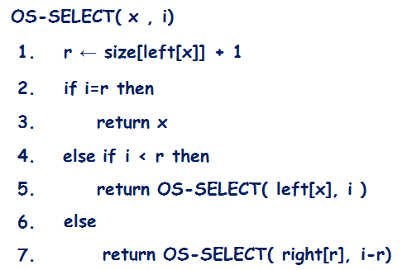
Learn DAA : From B K Sharma
Call OS-SELECT(root[T],17)
26
20
i=17
Is i=r:
No
r=13
Is i<r :
No
Is i>r :
Yes
17
12
41
7
i=i-r=4
r=6
14
7
21
4
i=4
47
1
30
5
r=2
10
4
16
2
21
1
19
2
28
1
38
3
i=2
7
2
12
1
r=2
14
1
20
1
35
1
3
1
39
1
Inorder Traversal: 3, 7,10, 12, 14, 14, 16, 17, 19,20, 21, 21, 26, 28, 30,35, 38, 39, 41, 47

Slide 19
Learn DAA : From B K Sharma
Order Statistics Tree
OS-RANK ( T , x )
OS-RANK ( T , x )
1.
r ← size[left[x]] + 1
2.
y ← x
3.
While y ≠ root[T] do
4.
if y=right[p[y]] then
5.
r ←r + size[left[p[y]]] +1
6.
y ←p[y]
7.
return r
Call OS-RANK(T,38)
i.e., we want to find the rank of node with key 38

Slide 20
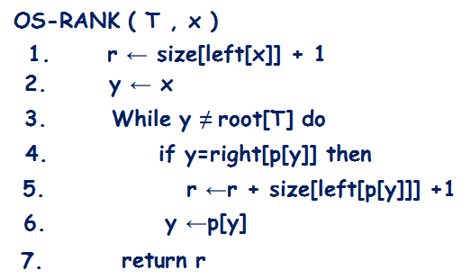
Learn DAA : From B K Sharma
Call OS-RANK(T,38)
26
20
r=17
y
41
7
r=4
17
12
Is y=right[p[y]]
y
: Yes
14
7
21
4
47
1
30
5
r=4
y
10
4
16
2
Is y=right[p[y]]
21
1
: NO
19
2
28
1
38
3
r=2
7
2
12
1
y
14
1
Is y=right[p[y]]
: Yes
20
1
35
1
3
1
39
1

Slide 21
Learn DAA : From B K Sharma
Analysis
OS-SELECT works down from the root x of the sub-tree on which it is used, stopping when the sought i^{th} order statistic is found.
Since the height of a red-black tree is O(lg n), OS-SELECT runs in maximum of O(lgn) time.
OS-RANK works up toward the root T of the tree on which it is used, stopping when the root is reached.
Since the height of a red-black tree is O(lg n), OS-RANK runs in maximum of O(lg n) time.

Slide 22
Learn DAA : From B K Sharma
Interval Tree
Def.:
a red-black tree each node having associated with an interval int[x].
The red-black tree is augmented with max[x], the maximum value of any interval endpoint stored in the sub-tree rooted in x.
[16, 21]
30
[8, 9]
23
[25, 30]
30
[5, 8]
10
[15, 23]
23
[17, 19]
20
[26, 26]
26
[0, 3]
3
[6, 10]
10
[19, 20]
20

Slide 23
Learn DAA : From B K Sharma
What are the steps of Augmentation Process?
Augmentation Process consists of four steps:-
1. Choose an underlying data structure:
Red-black trees
2. Determine additional information to maintain
max[x]
3. Verify that we can maintain additional information for existing data structure operations.
Show how to maintain size during modifying operations
4. Develop new operations
Developed INTERVAL-SEARCH(T, i):

Slide 24
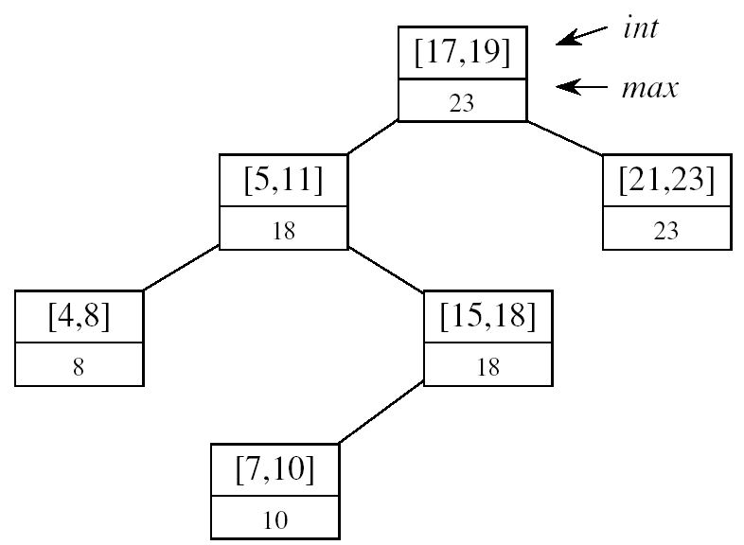
Learn DAA : From B K Sharma
How to find the max[x]?
max[x] =
maximum endpoint value in sub-tree rooted at x
high[int[x]]
max max[left[int[x]]]
max[right[int[x]]
max[x] =

Slide 25
Learn DAA : From B K Sharma
Interval Tree
Step 3:
Verify that we can maintain additional information for existing data structure operations.
Show how to maintain max[x] during modifying operations such as INSERTION AND DELETION.
We can determine max[x] given interval int[x] and max values of node x’s children:
high[int[x]]
max max[left[int[x]]]
max[right[int[x]]
max[x] =

Slide 26
Learn DAA : From B K Sharma
Interval Tree
[16, 21]
30
[8, 9]
23
[25, 30]
30
[5, 8]
10
[15, 23]
23
[17, 19]
20
[26, 26]
29
[0, 3]
3
[6, 10]
10
[19, 20]
20
[27, 29]
29
high[int[x]]
max max[left[int[x]]]
max[right[int[x]]
max[x]=

Slide 27
Learn DAA : From B K Sharma
Interval Tree
Step 4:
Develop new operations
Developed INTERVAL-SEARCH(T,i)
INTERVAL-SEARCH(T,x) :
Returns a pointer to an element x in T, such that int[x] overlaps interval i, or the sentinel nil[T] if no such element is in the set.

Slide 28
Learn DAA : From B K Sharma
Interval Tree
INTERVAL-SEARCH(T,i)
INTERVAL-SEARCH(T,i)
1.
x←root[T}
2.
While x≠nil[T] and i does not overlap int[x] do
3.
If left[x] ≠ nil[T] and max[left[x]] ≥low[i] then
4.
x ←left[x]
5.
else x ←right[x]
6.
return x

Slide 29
Learn DAA : From B K Sharma
Interval Tree
INTERVAL-SEARCH(T,i)
Interval i does not overlap int[x] iff:
high[i]
<
low[int[x]]
or
high[int[x]]
<
low[i]
low[int[x]
high[int[x]
high[i]
low[i]
i
x
x
i

Slide 30
Learn DAA : From B K Sharma
Interval Tree
INTERVAL-SEARCH(T,i)
Interval i does not overlap int[x] iff:
high[i]
<
low[int[x]]
or
high[int[x]]
<
low[i]
low[int[x]
high[int[x]
10
15
24
high[i]
18
low[i]
i
x
x
i
5
8
25
28
0
5
10
15
20
25
30
35

Slide 31
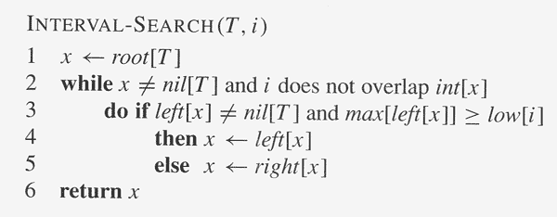
Suppose we wish to find an interval that
overlaps the interval i=[22, 25].
left[x]≠nil[T] and max([left[x] ≥low[i]
[16, 21]
30
x
23 ≥22
: Yes
9<22
[8, 9]
23
[25, 30]
30
x
10 ≥22
x
[5, 8]
10
[15, 23]
23
[17, 19]
20
[26, 26]
26
x≠nil[T] but i overlaps int[x] loop terminates
[0, 3]
3
[6, 10]
10
[19, 20]
20
high[i]
<
low[int[x]]
high[int[x]]
<
low[i]
25 < 16
: NO
21 < 22
: Yes

Slide 32
Learn DAA : From B K Sharma
Interval Tree
INTERVAL-SEARCH(T,i)
Analysis
Interval-Search works from the root of T down, stopping when the sought interval is found or a leaf, nil[T ], is reached.
Since the height of T is O(lg n), Interval-Search runs in O(lg n) time.

